Slide 1
Facilitating cross-border trade through a coordinated African response to COVID-19
Economic Commission for Africa
10 September, 2020
Addis Ababa, Ethiopia

Slide 2
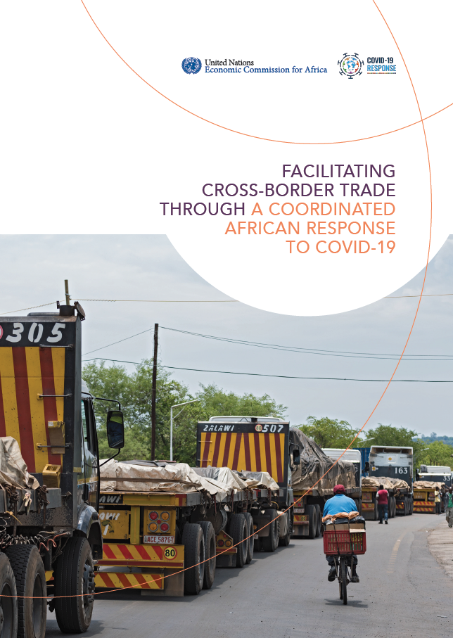
ECA COVID-19 Cross-Border Trade Report
CONTENTS
COVID-19 border restrictions and regulations
COVID-19 cross-border trade challenges
Status update: border operations and regulations
REC COVID-19 guidelines to facilitate trade
COVID-19: opportunity to overcome trade facilitation challenges
Policy recommendations

Slide 3

Safe trade: a balancing act
Closures: 38 and 17 countries have announced land and sea border closures, respectively
Target: under strict regulations, closures target reducing movement of people, while exempting essential supplies
Regulations: mandatory testing, sanitizing trucks, limiting crew members, and designated transit resting areas etc.
Minimize COVID-19 spread
Maintain cross-border trade

Slide 4
Slowdown in Africa’s trade
Africa’s exports, monthly (year-on-year % changes, 2020 vs 2019)
Source: Data from UNCTAD - based on national statistics from 2019 and 2020. Statistics for April 2020 are preliminary.
Notes:
UNCTAD data: intra-African exports declined by 17 percent in April 2020, but were more resilient to the twin COVID-19 and commodity price shock than Africa’s exports to the ROW → highlights importance of developing competitive and diversified intra-African value chains

Slide 5
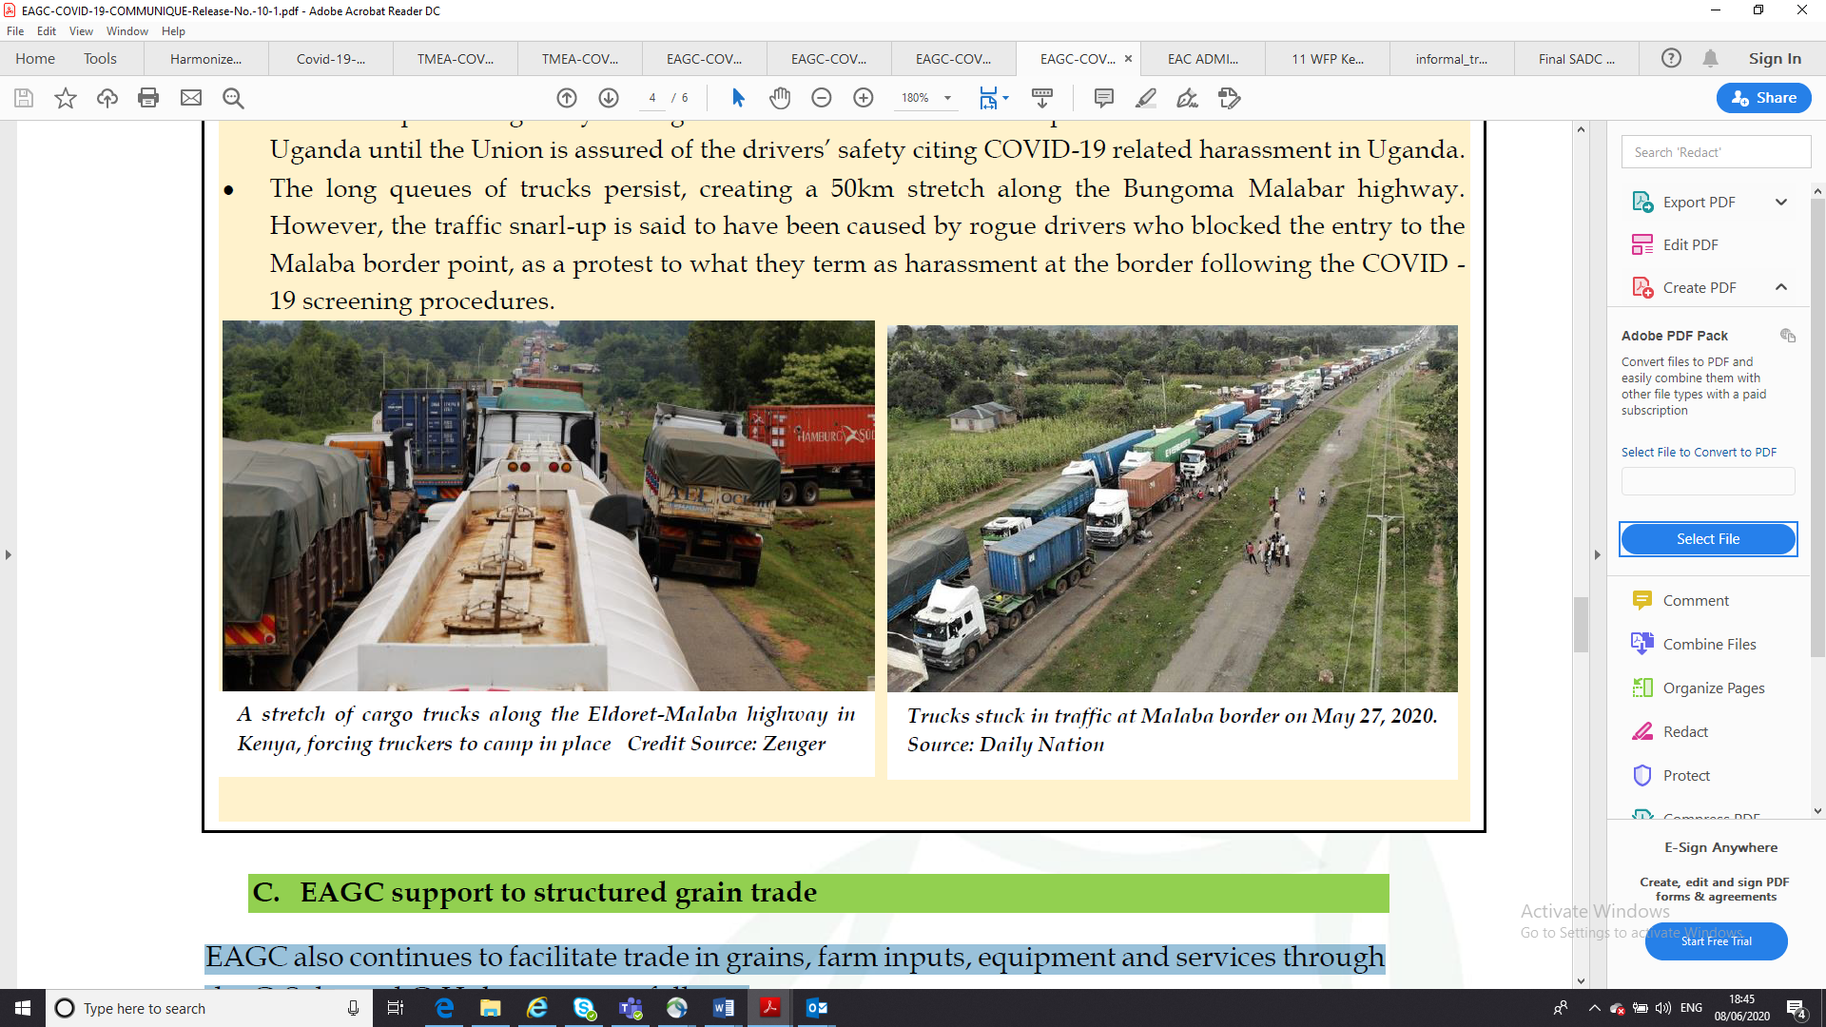
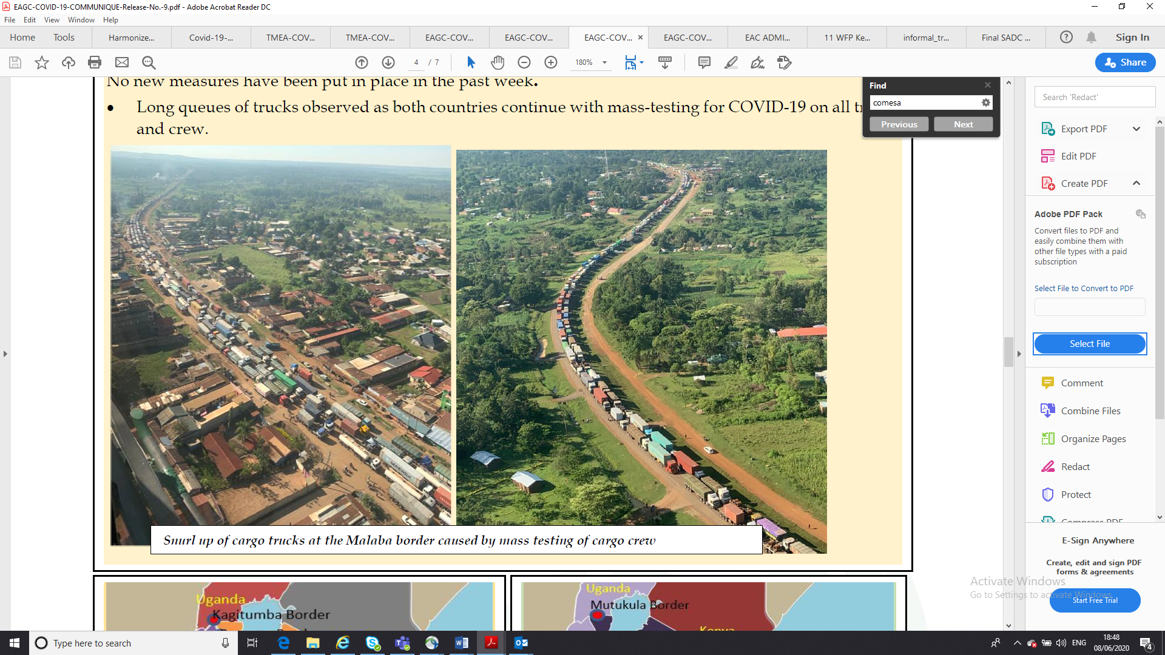
Cross-border trade disruptions
Trucks at the Malaba border in Uganda, 27 May 2020
Source: Eastern Africa Grain Council
Notes:
Cross-border trade disruptions: present challenges for Africa’s fight against COVID-19, and risk reversing progress towards the SDGs and AU Agenda 2063
Response: RECs introduced coordinating responses to facilitate “safe” and timely cross-border trade

Slide 6
Cross-border trade challenges
Health
Industrial development
Food security
Poverty Reduction
Gender equality
Income
generation
Financial
inclusion
Notes:
Key challenges
Inadequate or delayed access to emergency COVID-19 supplies
Increased food insecurity
Escalation of prices along key corridors including cities
Loss of income for informal small-scale cross border traders
Increased financial stress
Reversal in gains in women’s economic empowerment
Slowdown in the development of cross-border value chains

Slide 7
COVID-19 cross-border trade challenges
Maize prices in East Africa, growth rate (% changes, 2020 vs. 2019)
Source: ECA estimates based on data shared by Eastern Africa Grain Council
Notes:
Cross-border trade provides a lifeline for local communities and urban cities spanning entire corridors. Lower volumes of cross-border trade translate into lower supplies and increased prices, other things being equal.
In East Africa, many farmers have been unable to move their produce to border markets, which has cut off a vital source of cross-border trade. Much of the food crossing borders ends up in cities in East Africa, which are now experiencing price hikes.
This figure shows the broad increase in the prices of maize, a key food staple in East Africa, focusing on cities in the following countries: Burundi (Bujumburu), United Republic of Tanzania (Dar es Salaam), Kenya (Nairobi), Rwanda (Kimironko) and Uganda (Kampala), comparing the month in 2020 with the same month in 2019. For example, in Bujumburu, maize prices increased significantly, by about 33 per cent in January 2020, 13 per cent in February 2020, 2 per cent in March 2020, 49 per cent in April 2020 and 37 per cent in May 2020, compared to the same months in 2019.

Slide 8
Comparison of REC COVID-19 guidelines
 | COMESA | EAC | ECOWAS | SADC
Trade facilitation of essential supplies | X | X | X | X
Cross-border freight transport operations | X |  | X | X
Air transport | X |  | X
Handling of cargo at seaports | X | X | X
Transit deliveries | X | X
Trade in services | X |  | X | X
Payments and communications |  | X
Inspection and quality control |  | X |  | X
Advocacy, capacity building and information sharing |  | X | X
Gender considerations |  |  | X
Monitoring and evaluation | X | X | X | X
Notes:
SADC: first to be adopted on 6 April 2020
EAC: signed and published by EAC Regional Coordination Committee on COVID-19 Response on 24 April 2020, but not officially adopted by Member States
COMESA: adopted on 14 May 2020
ECOWAS: draft guidelines adopted by Ministerial Coordinating Committee on 17 June 2020, but not yet presented for adoption by Heads of State (not in force)
Challenge: Inconsistent implementation at national level and lack of harmonization across RECs

Slide 9




Best practice COVID-19 border responses across RECs
Health Screening
Testing and Certification
Mandatory health screening of drivers and crew
Coordinate health screens when there is a functioning OSBP
Ensure all border points have requisite personnel
Deploy mobile labs and test kits to border posts
Immediately isolate positive cases at borders
Develop regional test certificate and expedite clearance
Hygiene and PPE
Crew Size
Provide hygiene facilities and supply PPE at all border posts
Make mask-wearing and sanitary products mandatory
Provide disinfecting facilities
Introduce regulation to limit size of crew

Slide 10




Best practice COVID-19 border responses across RECs
Border Management
Information Sharing
Apply risk management on essential supplies only if high-risk
Pre-clear goods and coordinate inspections / single window processing
Designate priority lanes and safe parking facilities
Publish border measures taken to fight COVID-19
Distribute information at customs offices and border crossings
Publish route maps and facilities’ locations for truck drivers
Digital Solutions
Operational Mechanisms
Use electronic cargo tracking systems to facilitate contact tracing
Automate trade facilitation processes
Encourage e-payment platforms
Carry out capacity building of border staff
Establish a body to coordinate implementation of border regulations
Assist Member States to implement COVID-19 guidelines
Publish revised guidelines as may be required

Slide 11




Longstanding trade facilitation challenges
African Costs of Transportation
are 63% higher than developed countries
Freight Costs as % of Import Value
are 11.4% for Africa vs. 6.8% for developed countries
Customs Transactions include
20-30 different parties, 40 documents, 200 data elements
Customs Processing Delays
can cost $185 per consignment for each day of delay
Notes:
Studies show that on average, the costs of transportation in African countries are 63 percent higher compared to the average in developed economies and 135 percent higher than in Europe. The average cost of freight as a percentage of total value of imports is around 11.4 percent for Africa compared to 6.8 percent for developed countries (AFREXIMBANK, 2020).
According to AUDA-NEPAD, the average customs transaction in Africa involves 20–30 different parties, 40 documents, 200 data elements, and the rekeying of 60-70 percent of all data at least once. The typical multiplicity of government agencies operating on both sides of the same border doubles the bureaucracy at border posts and results in significant congestion and delays. It is estimated that cumbersome procedures entailed in customs processing can cost a consignment about US$185 for each day of delay (AUDA-NEPAD, 2020).

Slide 12
COVID-19: opportunity to overcome trade facilitation challenges
The crisis has magnified Africa’s cross-border inefficiencies
Increased urgency to do better and find innovative solutions to facilitate safe and efficient cross-border trade
Trade facilitation tools can be made COVID-19 relevant
One Stop Border Posts
Regional Transit Guarantee Schemes
Simplified Trade Regimes
Traffic Light System
Notes:
COVID-19 presents an opportunity to reinvigorate trade facilitation effortsThe crisis has magnified Africa’s cross-border inefficiencies - increased the urgency to do better and find innovative solutions to facilitate safe and efficient cross-border trade.
It will be important to maintain and upgrade these solutions post COVID-19, to lower trade costs, boost competitiveness, and support more resilient cross-border trade in the face of future shocks.
Various tools and interventions have emerged to respond to Africa’s trade facilitation challenges.
Many of these tools have been successfully piloted at specific borders or corridors, and can be easily tailored and extended to respond to COVID-19 border challenges

Slide 13
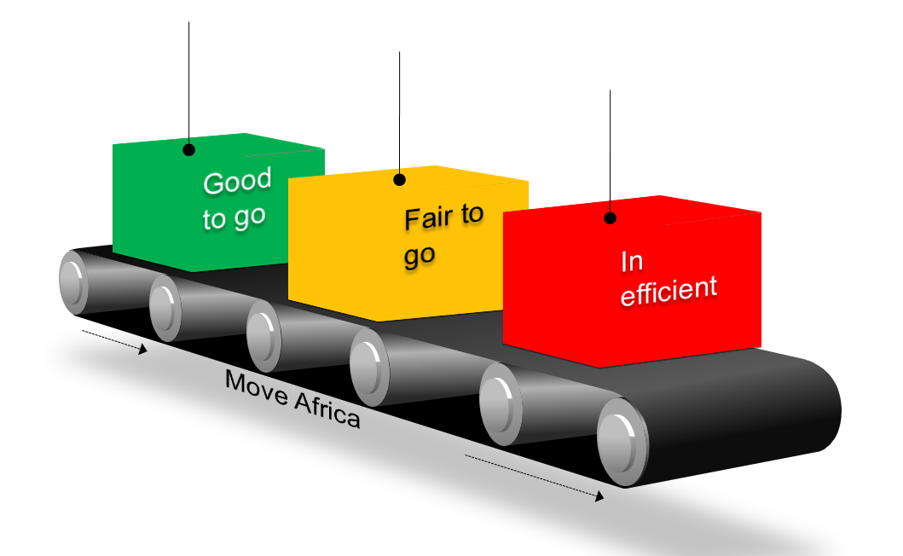
Making TLS COVID-19 relevant
AUDA-NEPAD Traffic Light System
Ranks performance of border posts and identifies bottlenecks and corrective actions
Successfully piloted: EAC, ECOWAS, SADC
Update to make COVID-19 relevant
Update existing indicators: reflect specific COVID-19 specific border challenges
Include new health & safety indicators
Regularly publish assessments

Slide 14
Key Action Areas
IMPLEMENT COVID-19 GUIDELINES
RECs can establish committees to coordinate guideline implementation and resolve border issues
Border authorities should develop simple visual step-by-step guides on COVID-19 border regulations
Expand guidelines to include all goods and services to move across borders
DEVELOP COMMON AU GUIDELINES
This is important given shared trade facilitation goals of the AfCFTA
It can build upon existing REC guidelines and “best practices”
A common AU COVID-19 Test Certificate for transport workers is required to facilitate a harmonized approach to certifying test results
MAINTAIN AFCFTA MOMENTUM
Speeding up AfCFTA implementation will hasten economic recovery
African counties can start to implement “ready-to-go” elements of the Agreement including NTB mechanism and Annexes on Trade Facilitation and Customs Cooperation

Slide 15
Key Action Areas
USE TRADE FACILITATION TOOLS
AUDA-NEPAD Traffic Light System can be updated to include COVID-19
Regularly published information on “relative” ease of movement and clearance at border posts to better inform logistical planning
Roll out COMESA RCTG bond scheme to other regions
DEPLOY DIGITAL SOLUTIONS
Electronic Cargo Tracking Systems can be scaled and replicated
Mobile banking and payment systems should be encouraged to reduce contact
AfCFTA should be utilized to fast track digitalization of procedures and systems to enhance competitiveness of African exporters
REFLECT INFORMAL TRADERS
Governments should take steps to reopen informal cross-border trade across official border crossings with sanitary, testing and quarantine facilities
Governments should assist small-scale traders to provide relief to informal traders
Full implementation of Simplified Trade Regimes would help to incorporate informal traders into official trading systems

Slide 16

THANK YOU!

